Slide 1
Random Variables
MATH 3342
Section 3.1

Slide 2
Random Variables
Given a sample space S of some random process:
A random variable (RV) is any rule that associates a number with each outcome in S.
In mathematical terms:
A RV is a function whose domain is the sample space and whose range is the set of real numbers

Slide 3
Notation
A RV is usually denoted by Uppercase Letters
Such as X or Y
Use a lowercase letter to denote a particular value a RV takes
X(s)=x
Indicates that x is the value associated with the outcome s by RV X

Slide 4
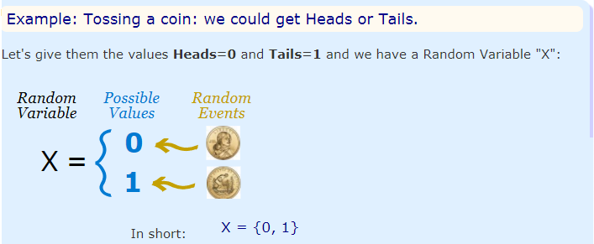
Example

Slide 5
Example
We'll start with tossing coins.
I want to know how many heads I might get if I toss two coins. Since I only toss two coins, the number of heads I could get is zero, one, or two heads.
So, I define X(my random variable) to be the number of heads that I could get
Notes:
http://study.com/academy/lesson/random-variables-definition-types-examples.htm
https://www.mathsisfun.com/data/random-variables.html

Slide 6
Example
A quality inspector examines four mp3 players and rates each as either acceptable or unacceptable.
First, you record the sequence of ratings.
Define the random variable X by recording the number of units rated acceptable.
Define the random variable Y by recording the number of units it takes to observe an unacceptable unit.

Slide 7
Example
A polling organization uses a random number dialer to conduct a short survey by randomly calling phone numbers within a given area code.
Define an appropriate RV X to denote whether or not a person who answers completes the survey.

Slide 8
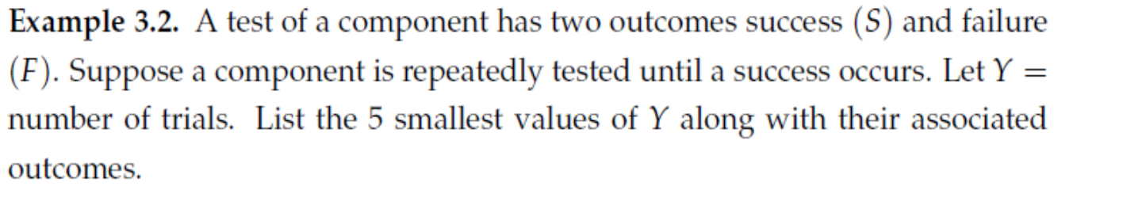
Example

Slide 9
Example

Slide 10
Example

Slide 11
Bernoulli Random Variables
Any random variable whose only possible values are 0 and 1.

Slide 12
Example
The quality control branch of a furniture company randomly selects a computer desk at random to test how much weight can be placed on it before it breaks.
Define a RV X to describe the outcome of this test.

Slide 13
Two types of Random Variables
Discrete
The remainder of Ch. 3
Continuous
Ch. 4

Slide 14
Discrete Random Variables
An RV whose possible values either:
Constitute a finite set OR
Can be listed in an infinite ordered sequence

Slide 15
Continuous Random Variables
An RV for which both of the following are satisfied:
The set of possible values consists of either:
All numbers in a single interval on the number line OR
All numbers in a disjoint union of such intervals
No possible value of the RV has positive probability
i.e. P(X=c) = 0 for any possible value of c
Notes:
That single interval is possible infinite

